Slide 1

Big Mountain Resort
Refining pricing strategy

Slide 2
Problem Statement
Big Mountain Resort recently installed another chair lift that would help visitors to get on top of skiing hills faster, but this increased their projected operating cost for the season by $1.5 million. The resort is hoping to compensate for this increased cost by refining their ticket pricing strategy, by the end of this season.

Slide 3
Key Findings and Recommendations
After analyzing more than 300 skiing resorts across the US, the following can be concluded:
Top 4 features affecting ticket prices are:
Highest vertical drop
Areas covered by snow making machines
Total number of runs
Total number of fast quad chairs
Big Mountain Resorts are well above market average on all 4 features
Big Mountain Resorts should increase the ticket price to $94

Slide 4
Linear Regression vs. Random Forest
Both models' hyperparameters were optimized with 5 fold cross validation
70% of the data was used for training, and 30% for testing
Linear regression model is on average $10.49 off on testing set
Random forest model is on average $9.50 off on testing set
Random forest model will be used for predictions

Slide 5
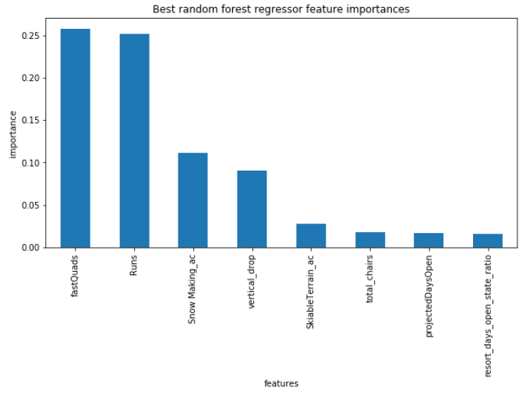
Random Forest Model: Most Important Features
Original data set has 25 features recorded for each resort, most of them are not important to be considered for the future improvement of Big Mountain Resort
The following are the 8 most important features, emphasis on the top 4

Slide 6
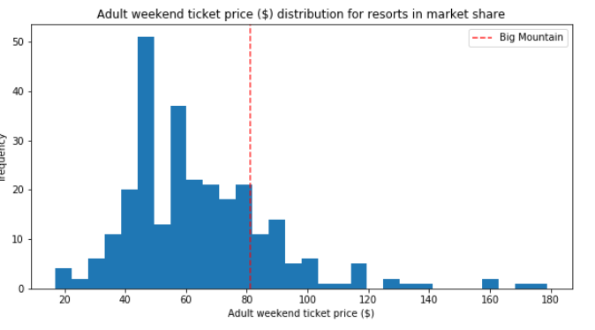
Random Forest Model: Prediction
The above is Big Mountain Resorts current ticket price compared to the market
Even though the price is already above average, the random forest model predicts the price can be further increased to $94

Slide 7
Conclusion
By increasing Big Mountain Resort's ticket price from $81 to $94, it will see more than $22 million increase revenue per season
Is it enough to cover the increase operating cost this season? YES!
For future improvements of the resort, it should focus on these 4 features:
Highest vertical drop
Areas covered by snow making machines
Total number of runs
Total number of fast quad chairs

